Slide 1
Topic : Quadratics Introduction
Term 4 – Week 4
Ms. Latham
Year 10 – Coordinate Geometry
EQ: How do I graph quadratic equations?

Slide 2
Overview
Understand the different parts of a quadratics equation
How the different parts will transform when graphed
Students will need a half page of graph paper

Slide 3
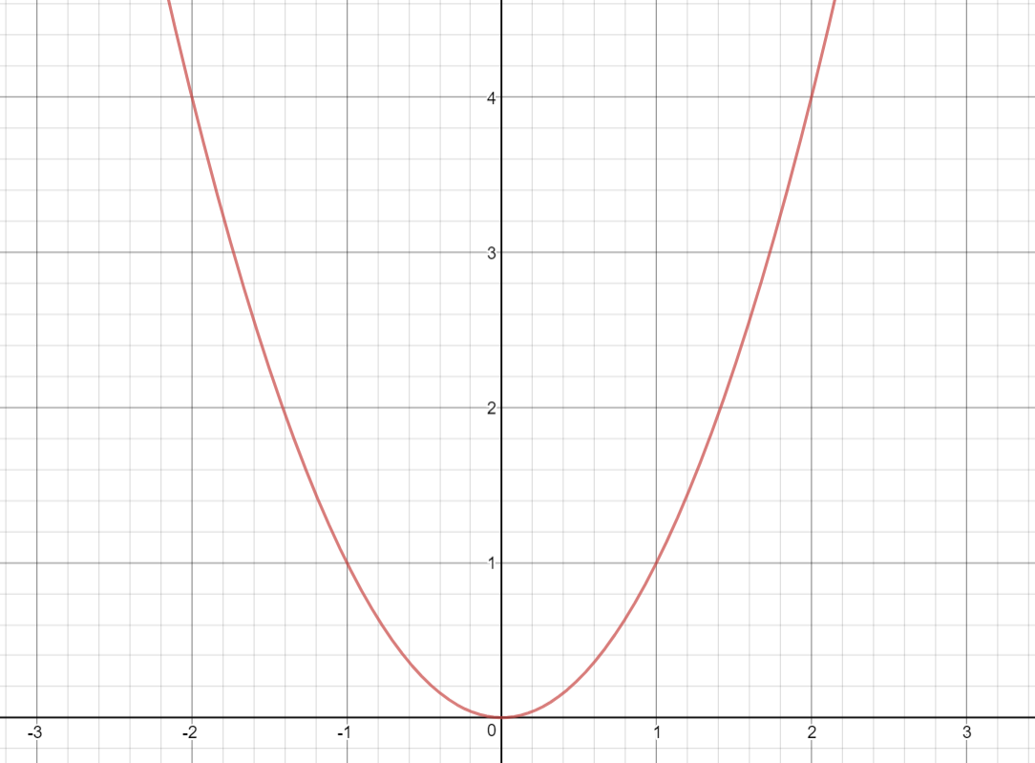
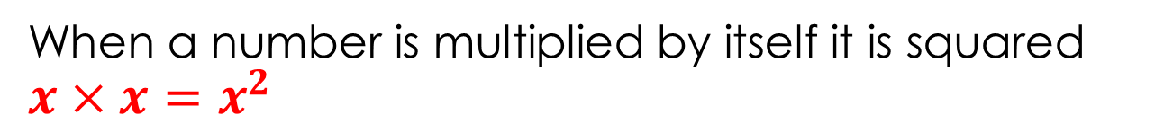
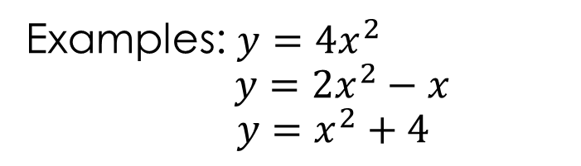
Topic : Quadratics Introduction
How do I graph quadratic equations?
What does squaring mean?
When a number is multiplied by itself it is squared $x×x=x^{2}$
Standard form
$$y=ax^{2}+bx+c where a≠0$$
Examples: $y=4x^{2}$
$$y=2x^{2}−x$$
$$y=x^{2}+4$$
What is a parabola?
A parabola is a graph of a quadratic equation. It is symmetric.

Slide 4
Topic : Quadratics Introduction
How do I graph quadratic equations?
$$y=ax^{2}+bx+c where a≠0$$
Parts of the graph:
The vertex is the peak of the graph. Can point upward (maximum) or point downward (minimum)
Vertex
Roots or Zeros
X-intercepts
(where the graph crosses the x-axis i.e. when y=0)
Not all parabolas have an x-intercept
Axis of Symmetry
The vertical line containing the vertex.

Slide 5
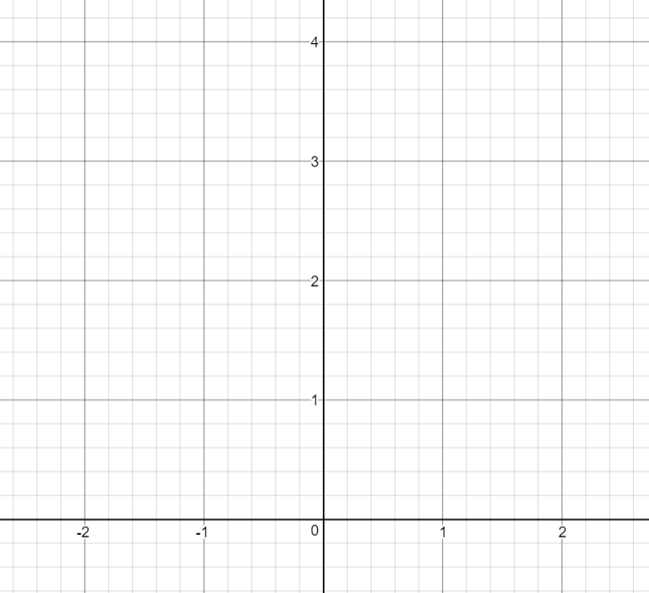
Topic : Quadratics Introduction
How do I graph quadratic equations?
Graphing exactly
Quadratic equations are graphed in the same way as linear equations are graphed.
Choose your x values e.g. -1, 0, 1
Y=x²
X | -2 | -1 | 0 | 1 | 2
y
On your graph paper set up your axis
-5<y<20 and -5<x<5
And plot y=x² for all the values of x.
2. Substitute the x values into the equation to find the y value
3. Graph the coordinates onto a cartesian plane
Notes:
Fill in the table with the students

Slide 6
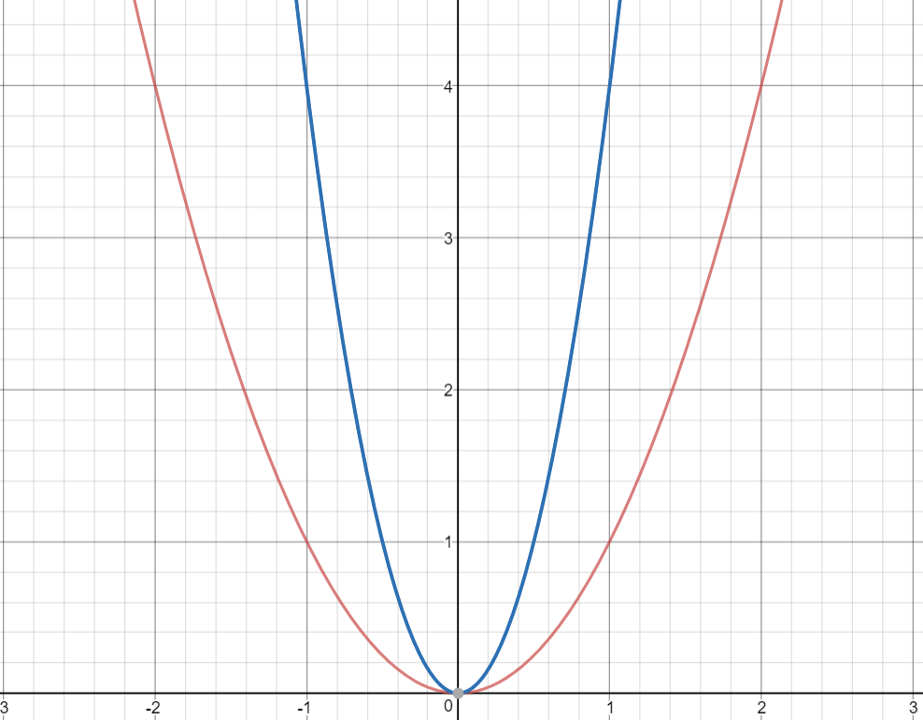
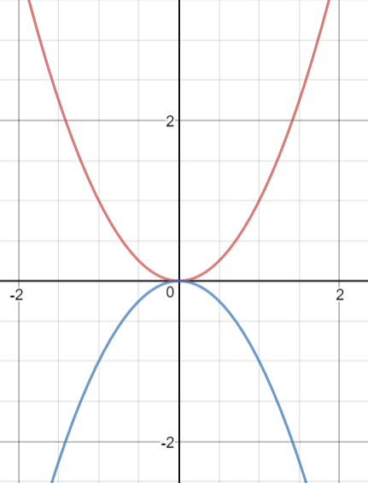
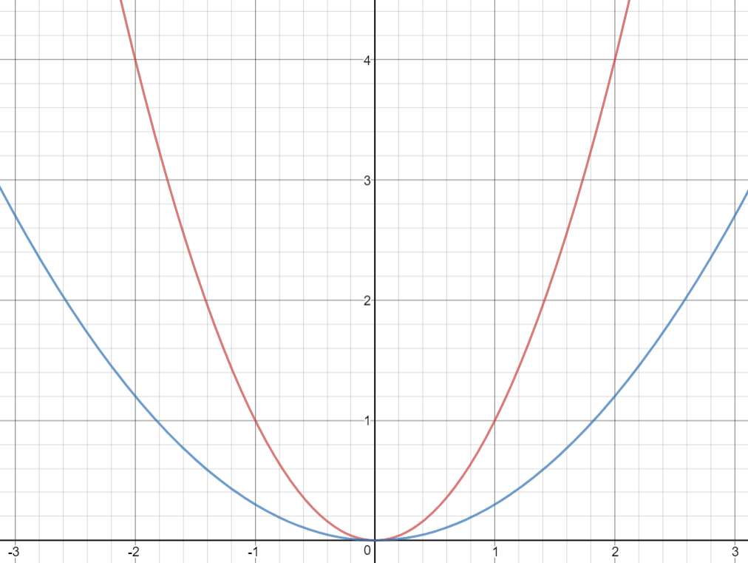
Topic : Quadratics Introduction
How do I graph quadratic equations?
a=1
Sketching
A quadratic can be sketched as a transformation of y=x²
Any value of a that is greater than 1 will make the parabola more narrow
a=4
Y=ax²
Any value of a that is less than 1 will make the parabola wider
a=0.3
a=-1
A negative a will flip the parabola

Slide 7
Complete the table for the 3 equations and then plot on the graph.
y=4x²
2. y=0.3x²
3. y=-x²
X | -5 | -4 | -3 | -2 | -1 | 0 | 1 | 2 | 3 | 4 | 5
y
X | -5 | -4 | -3 | -2 | -1 | 0 | 1 | 2 | 3 | 4 | 5
y
X | -5 | -4 | -3 | -2 | -1 | 0 | 1 | 2 | 3 | 4 | 5
y

Slide 8
Write your summaries

